Slide 1
DIGITAL PHOTO FRAME
ROBOTICS CLUB
SUMMER PROJECT 2016
PROJECT MENTOR : HEMANT KUMAR
TEAM MEMBERS:
ABHINAY KUMAR
SAGAR GOYAL
K. SIDDHARTH
YASH KHATRI

Slide 2
OBJECTIVES
A digital photo frame which has a user end app and a photo frame end web app.
To send and display photos on the digital photo frame using the same apps.
To send reminders on to the digital photo frame.
Build a automatic medicine dispenser that is attached to the photo frame.
To control a medicine dispenser using the same app using time shown in digital photo frame.

Slide 3
BASIC FRAMEWORK OF DPF
SERVER
APP
PHOTO FRAME
Components of Server
MYSQL
PHP

Slide 4
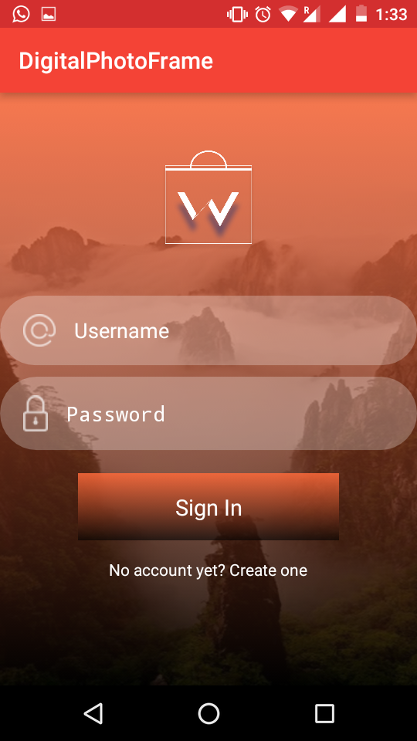
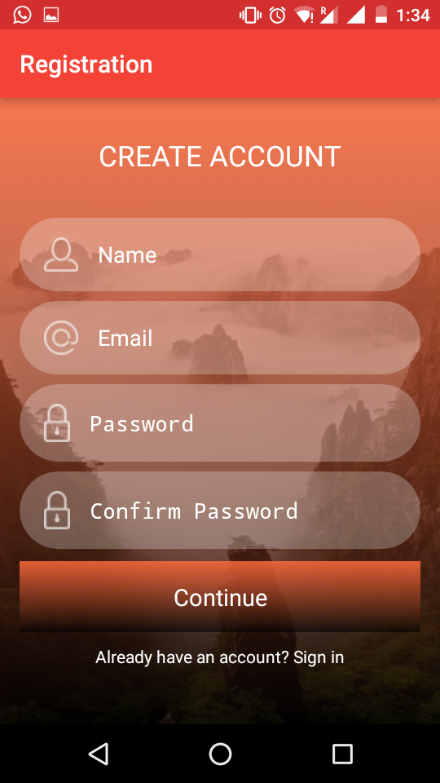
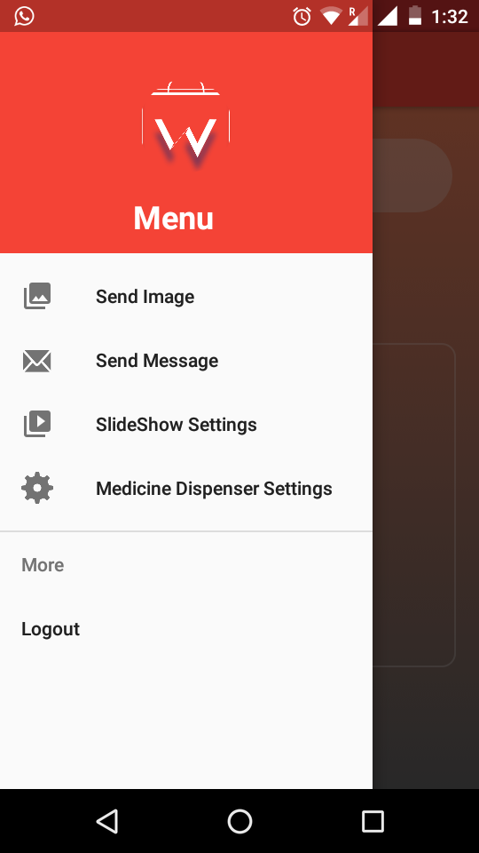
USER END APP

Slide 5
DATA FLOW IN APP
Not registered
registration
Stored in table user
Returns to login
user
Login
Database
Table upload
Table message
Table settings
Retrieves information from database
Select Image
Uploads
Image
Open Options activity
Send message
Sends
Message
Medicine dispenser
Sends
Settings

Slide 6
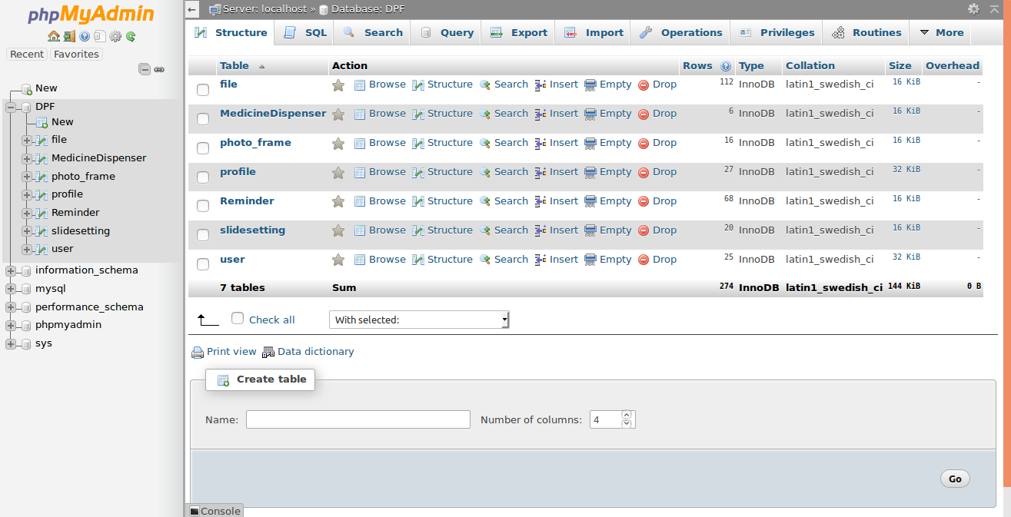

Slide 7
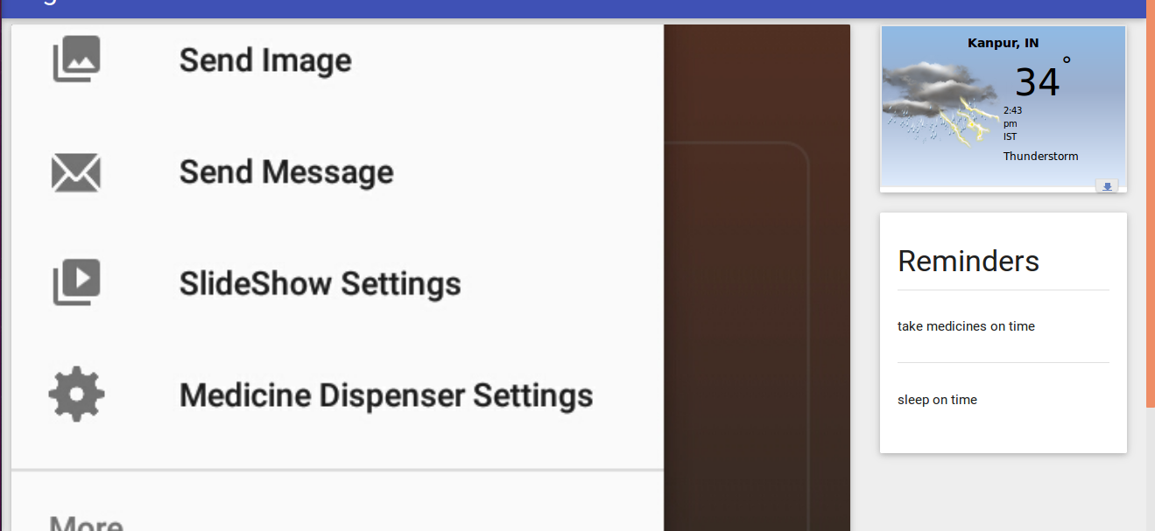
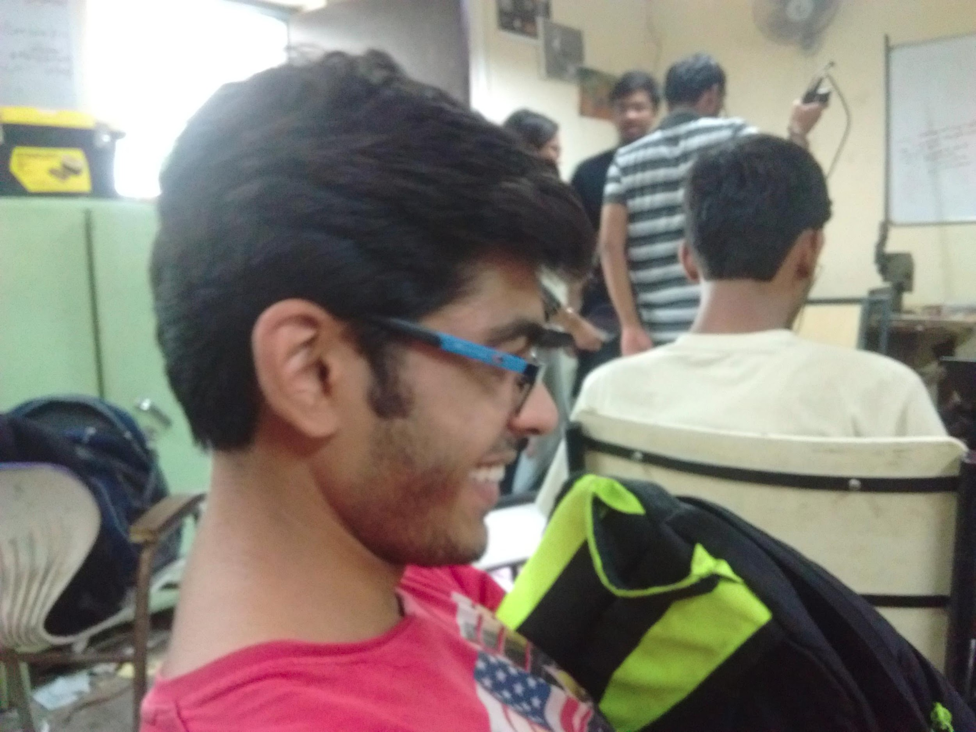
PHOTOFRAME END WEBAPP

Slide 8
HOW PHOTO FRAME END APP WORKS
READS DATA FROM DATABASE AND RETURNS IT IN JSON FORMAT
SERVER
APP
SEND ID OF PHOTOS
SLIDESHOW FRAGMENT
SEND REMINDERS
SEND WEATHER INFO
REMINDERS
WEATHER

Slide 9
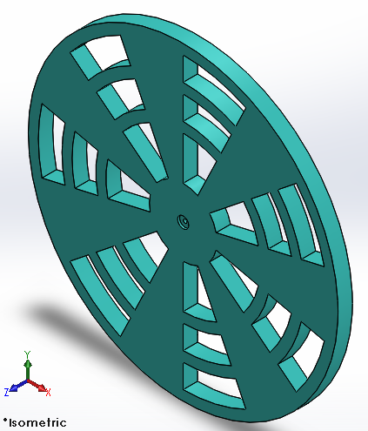
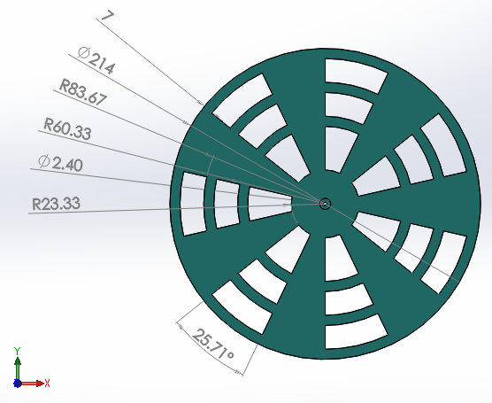
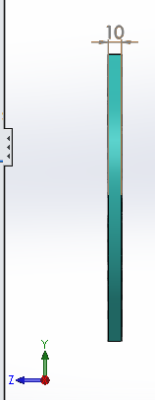
Automatic Medicine Dispenser
TOP LAYER

Slide 10
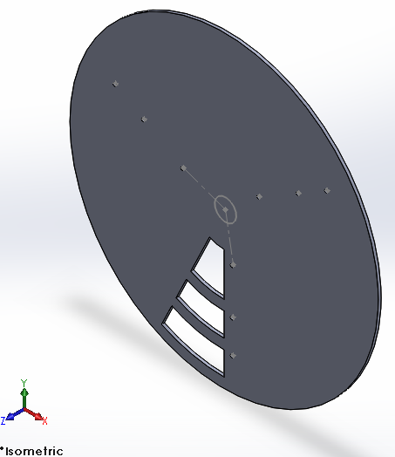
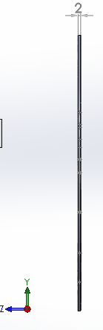
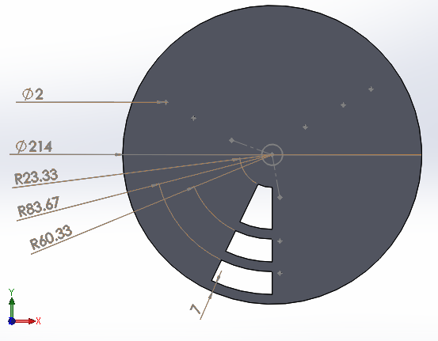
2. MIDDLE PLATE

Slide 11
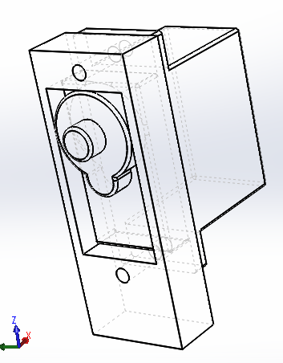
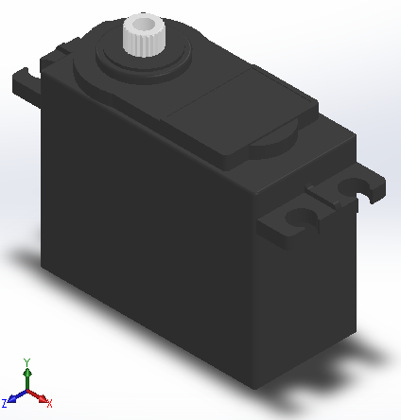
3. OTHER COMPONENTS
MICRO-SERVO EMBEDDED IN SLAB
HS-422

Slide 12
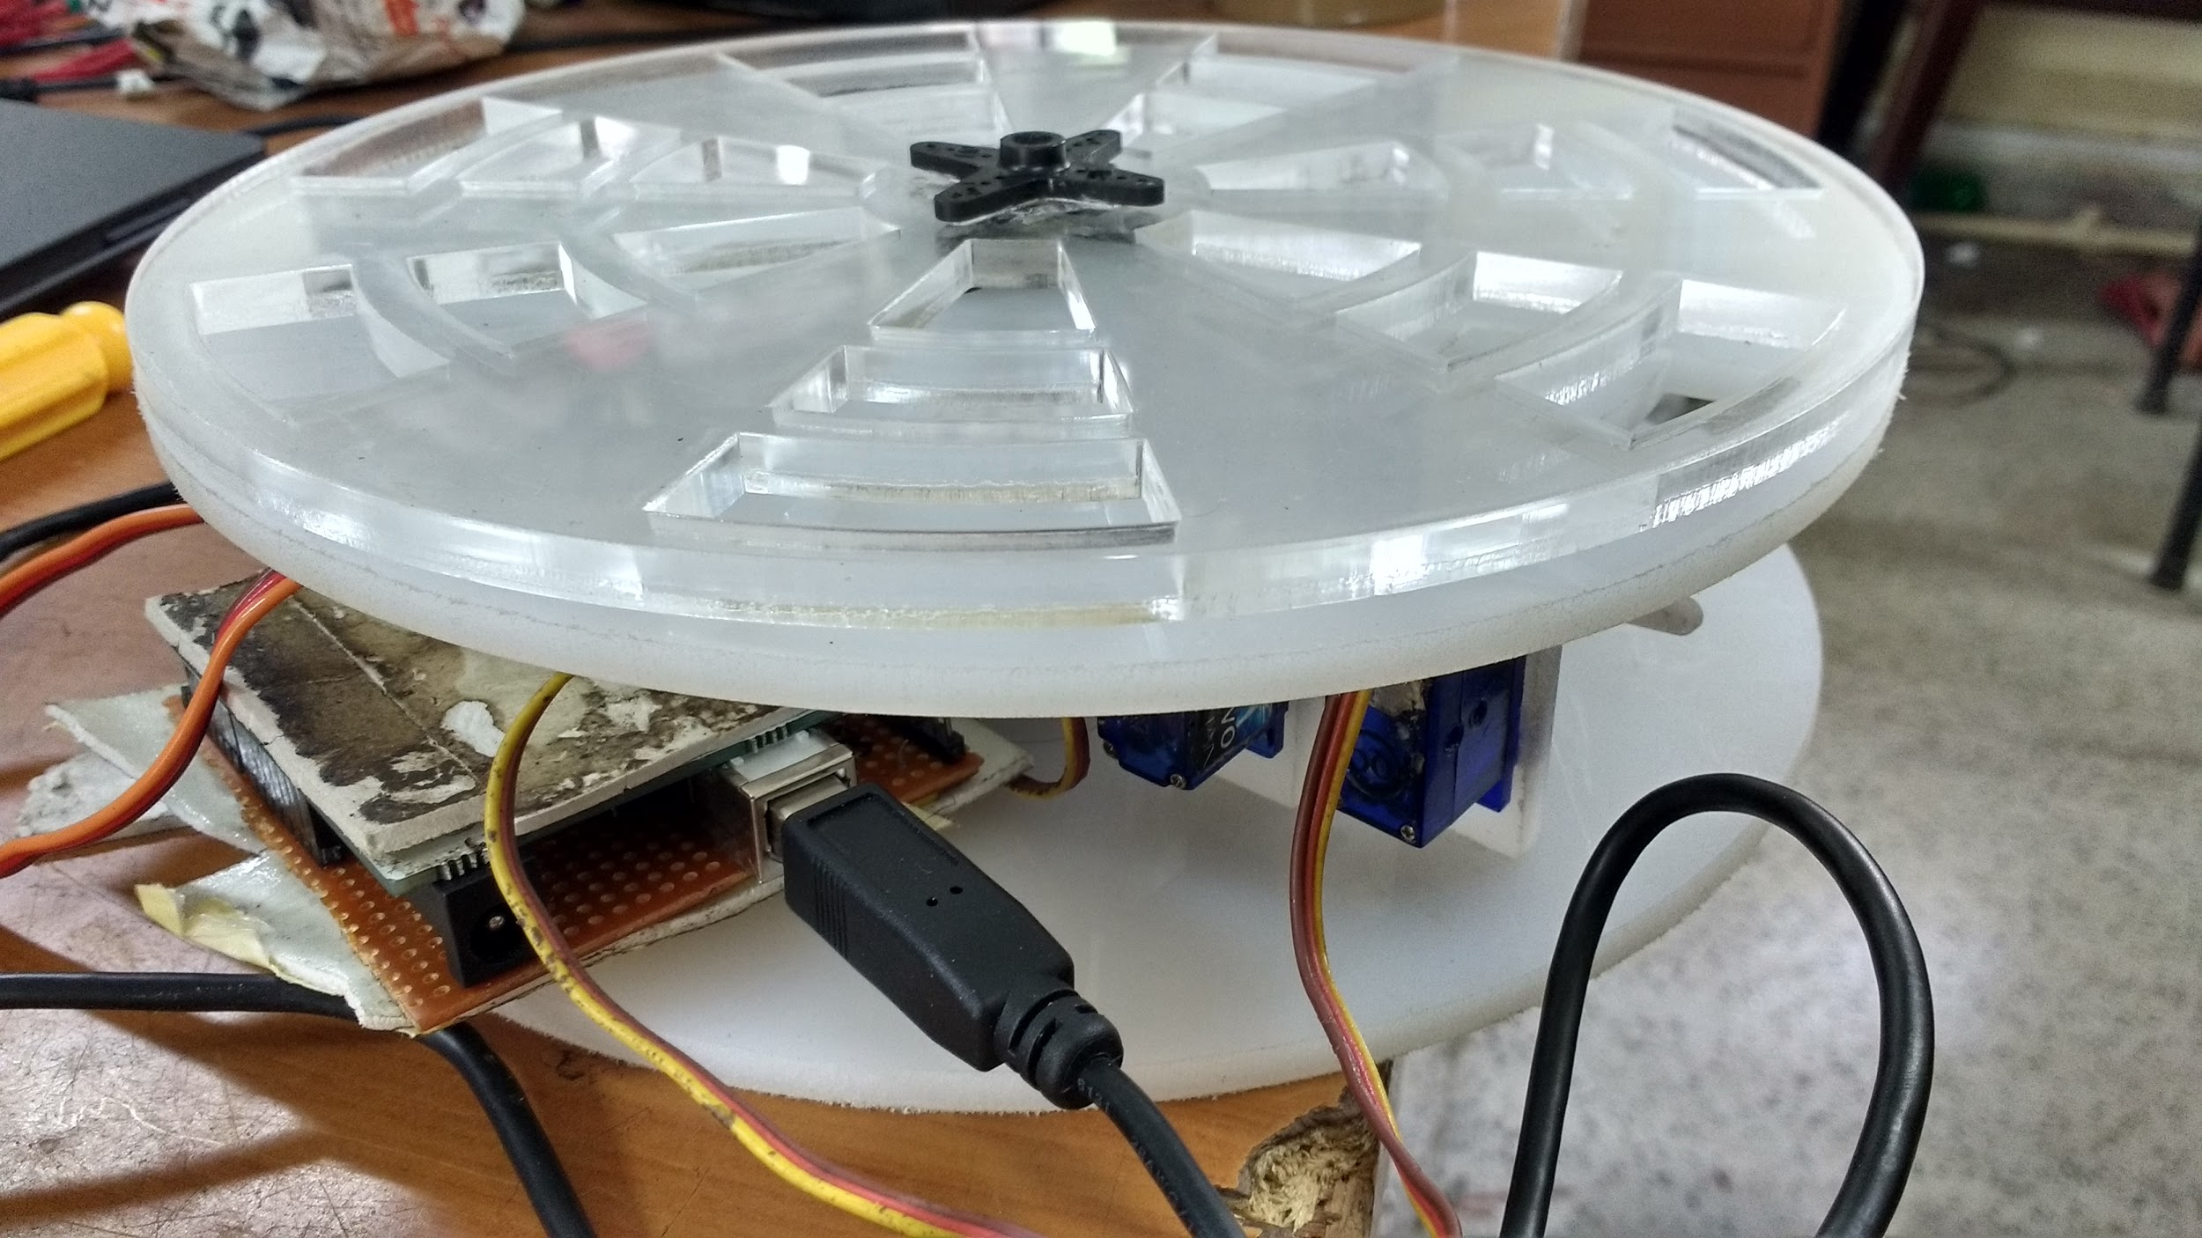
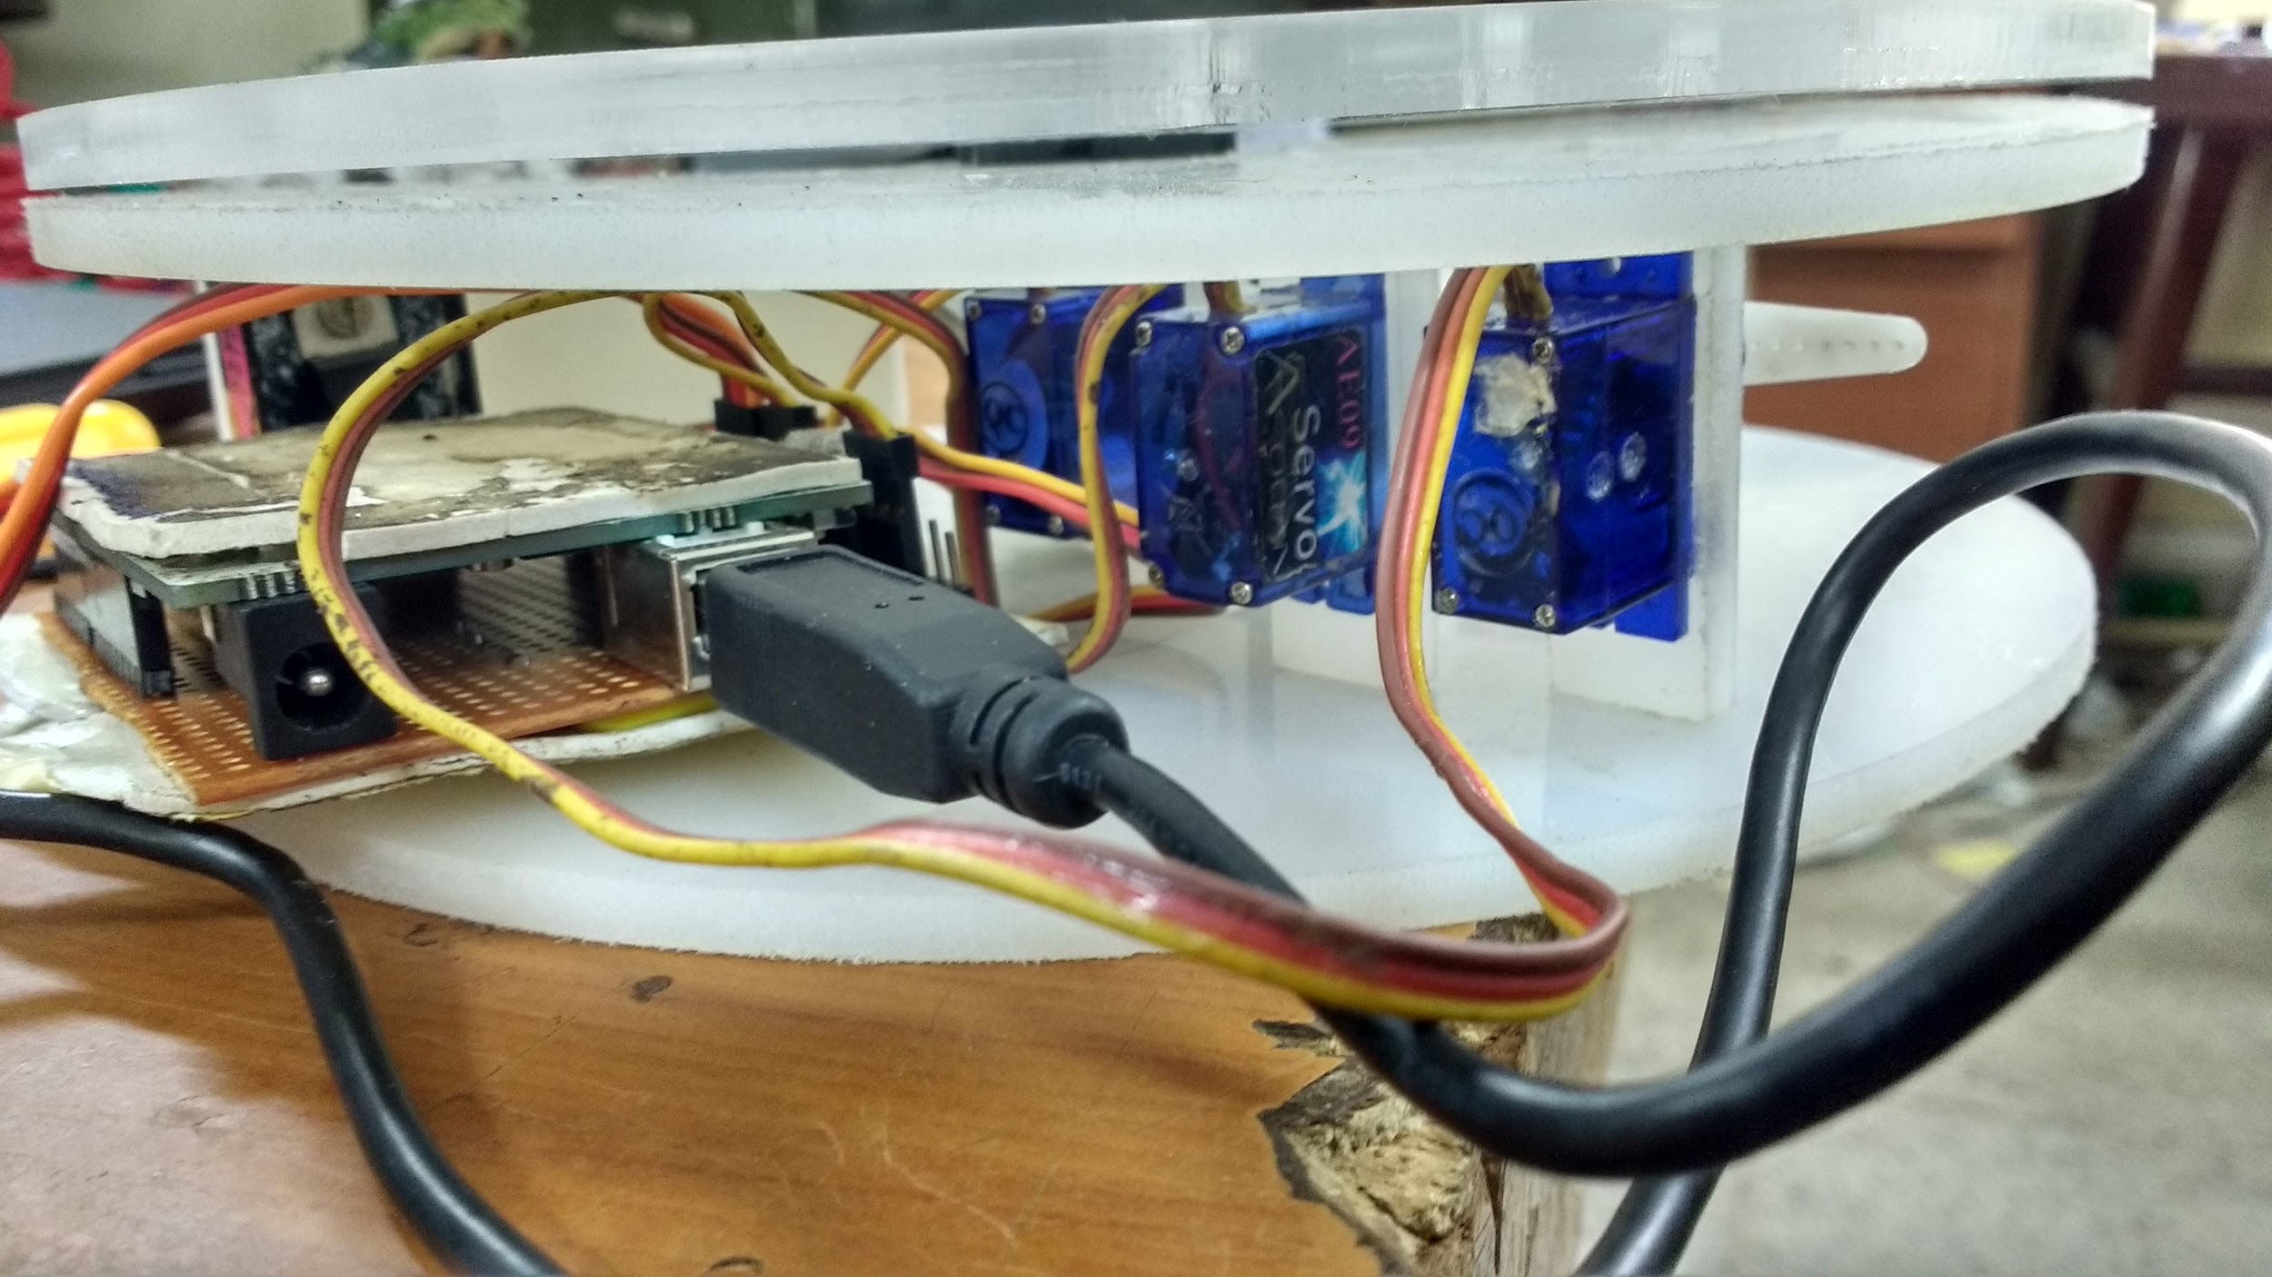
THIS IS WHAT THE FINAL ASSEMBLY LOOKS LIKE.
/home/abhinay/Videos/V_20160627_113748.mp4

Slide 13
FUTURE PLANS
To install and use android on embedded processor such as Raspberry Pi,odroid for the photo frame end.
To remove some server security issues related to the server.
To connect photo frame to multiple users.

Slide 14




SOFTWARES USED

Slide 15


